Slide 1
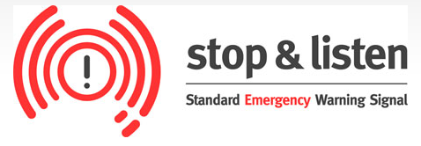

Standard Emergency Warning Signal (SEWS)
Standard Emergency Warning Signal (SEWS) © State of Queensland (Queensland Fire and Emergency Services) http://www.disaster.qld.gov.au/Warnings_and_Alerts/About_SEWS.html CC BY 4.0 creativecommons.org/licenses/by/4.0/deed.en
When a destructive weather event such as a cyclone is predicted to affect a particular region, a distinctive audio signal is broadcast on television and radio prior to any announcement or advice relating to the event. There are strict rules on the use of this warning signal in Queensland.
Double click the audio button to the right to hear the signal.
After the sound plays the presenter would provide details of the emergency situation. In the case of cyclone information such as the cyclone’s category, wind speed, direction, estimations on when it will reach certain locations, precautions that should be taken and when the next update will be available would be broadcast.

